Slide 1

UFO and Meteors Capstone
By: Wiley Martin

Slide 2
Overview
Downloaded two separate datasets into Excel, one dataset containing UFO sightings and the other containing information on meteorite landings
Cleaned blank spaces and invalid time date formats in Excel
Imported these datasets into Python to further analyze and create graphs
Utilized Power Bi to import these datasets and create map visualizations to identify where UFOs and meteors were located across the world

Slide 3
Agenda
Data Question
Known Issues / Challenges
Findings
Minimum Viable Product

Slide 4

Data Question
Is there a correlation between the location of meteorite fallings and the count of UFO sightings in certain areas of the country?

Slide 5

Potential/Known Issues
Issues of credibility behind sightings of the UFOs
Inaccuracy of UFO location sightings
Missing Data

Slide 6
UFOs Over the Years
Notes:
This graph represents the number of UFOs over certain years in descending order by count of UFOs. The greatest count of UFOS is 6,450 in 2012. The second most is 6,202 in 2013, and the year with the smallest number of counts is 2009 with 3,715.

Slide 7
Different Types of UFOs
Notes:
This graph represents type of UFO shapes in descending order in terms of count with light containing the greatest number of occurrences at 14,130.

Slide 8
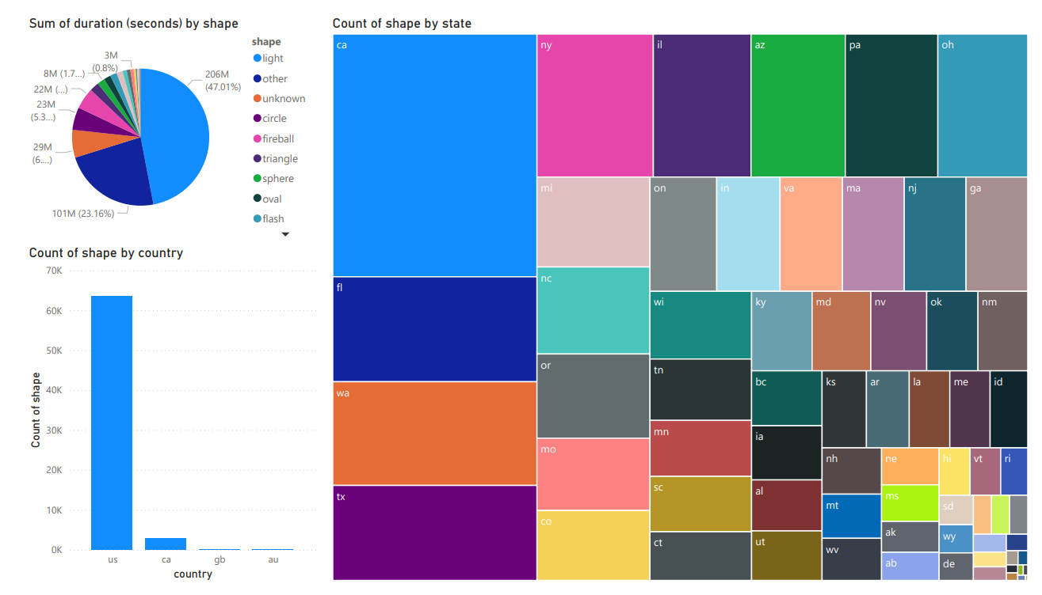
UFO Information
Notes:
I utilized the pie chart visualization in PowerBi to display the different types of meteors in terms of shape and how long they took to fall, with light being the shape with the largest duration. The next visualization is a bar chart that displays the count of the meteor shape by country in this dataset with U.S. containing the most. Lastly, I added a tree map of all the states in the U.S. and the count of UFO shapes seen within those states.

Slide 9
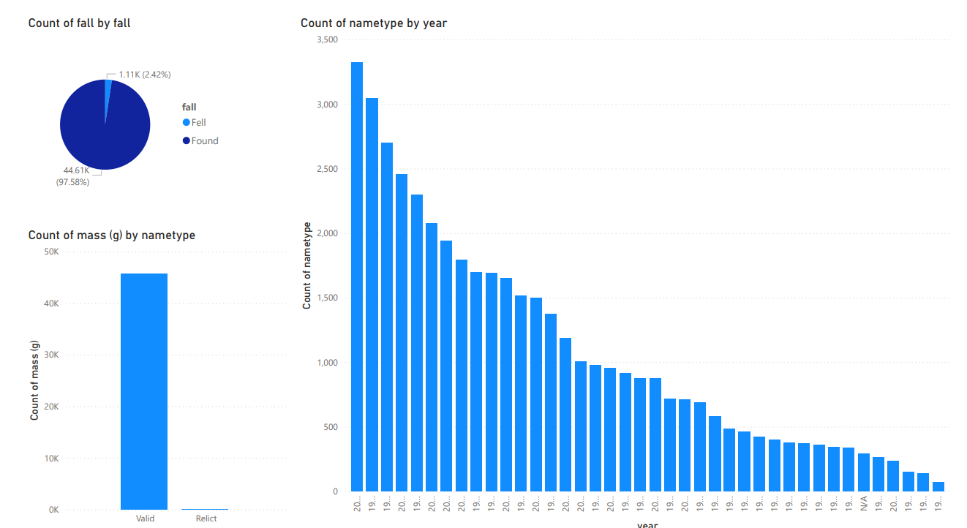
Meteor Information
Notes:
Meteors are classified as either valid or relicts within this dataset and whether they were found or seen when they fell from the sky. 2003 had the count of the most meteors with 3,223 different meteors. 1979 was the next most with 3046 counts, and the year with the smallest number of meteors in this dataset is in 1969.

Slide 10
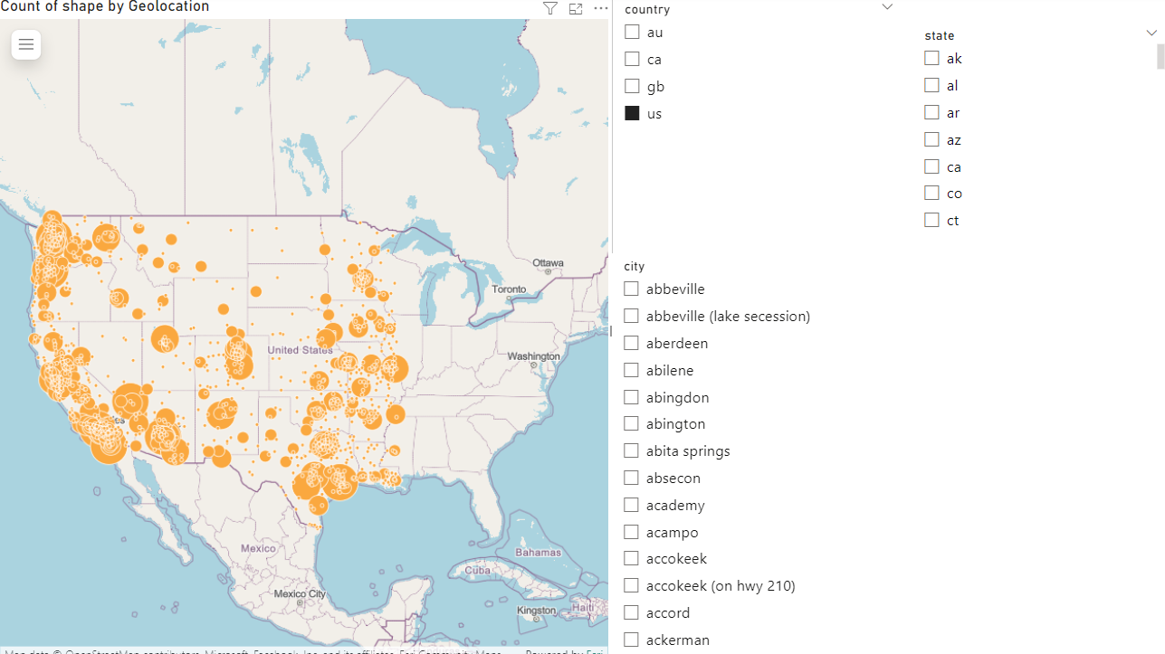
UFO Sightings Across the U.S.
Notes:
This visualization from PowerBI displays the count of UFO sightings across the U.S. with the bubble size being impacted by the count of the UFOs seen in the U.S. As you can see California has the most amount of clusters in this dataset and there are several clusters of sightings in the Pacific Northwest, New Mexico, and Nevada.

Slide 11
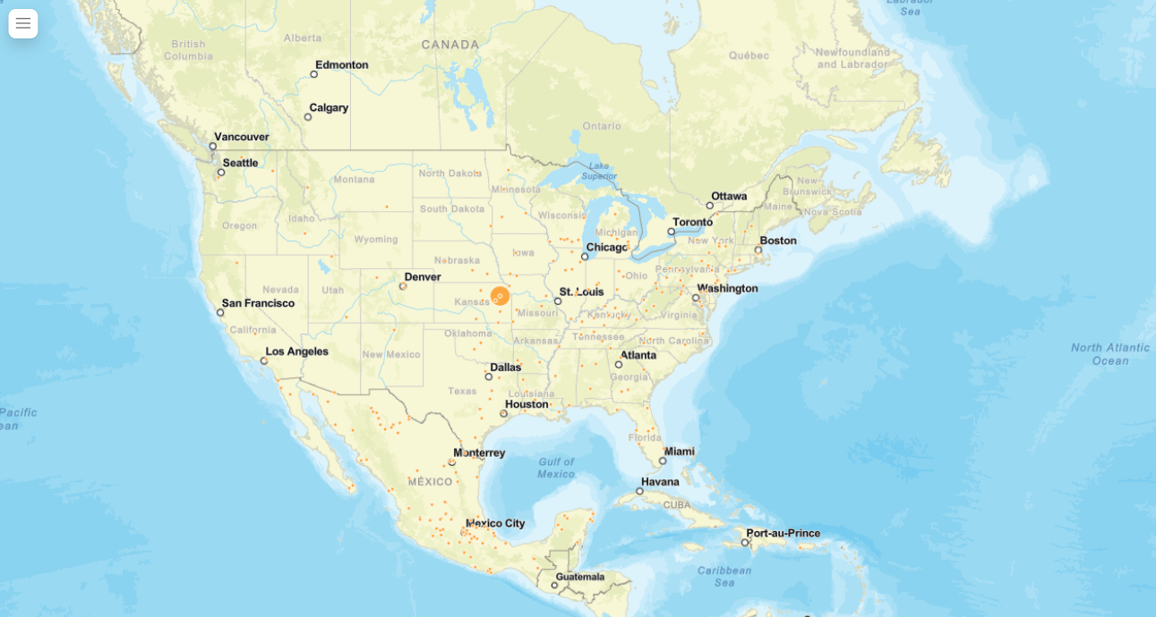
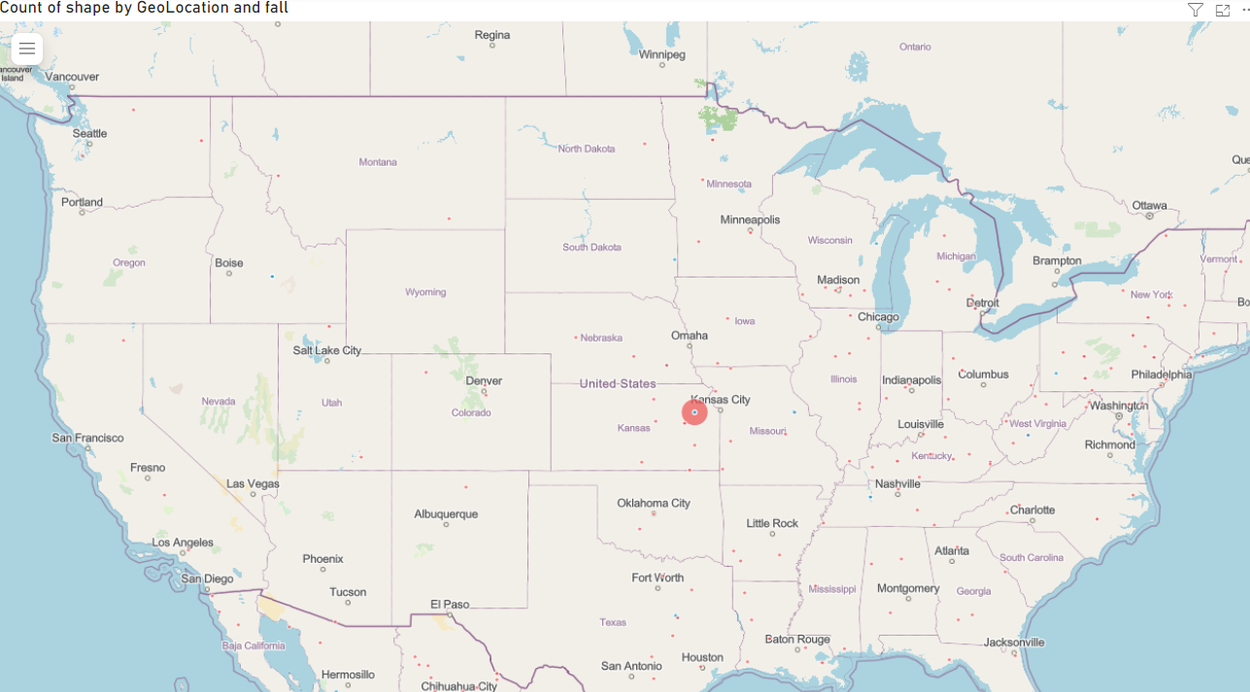
UFOs in Relation to Meteor locations
Notes:
To answer my data question, I had to utilize an ArcGIS map in PowerBi to tie the meteorites dataset and UFO datasets together. I used the geolocation of meteors and the count of UFO comments to reflect bubble size. By doing this I was able to see what states in the U.S. displayed a tie between UFO sightings and meteor locations. Topeka, Kansas was the city that stood out the most in terms of indicating a positive relationship between the two variables in the U.S.

Slide 12
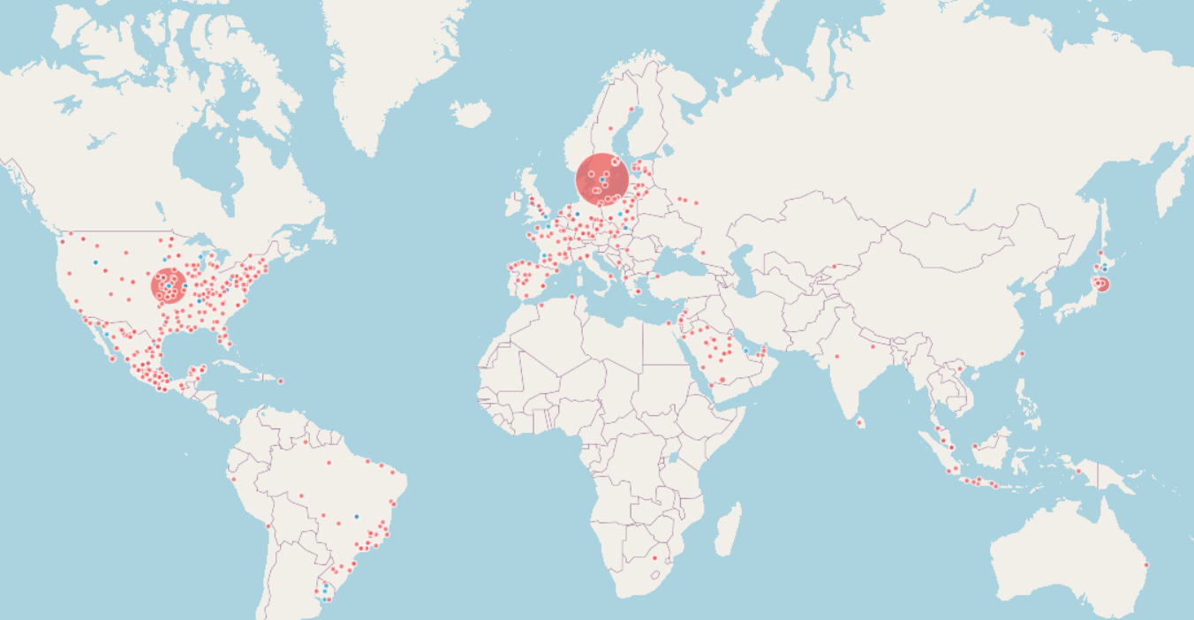
UFO Sightings Across the World
Notes:
Taking a broader view of the ArcGIS map created you can see that there were some locations outside of the U.S. indicating a positive relationship between location of meteors and the count of UFOs seen. As you can see Topeka, Kansas is still the largest bubble size in the U.S., but the other areas located on this map with large counts of UFO sightings were Stockholm, Sweden
and Sendai, Japan. The red dots indicate meteors that are classified as “fallen” with the blue dots indicating meteors that were “found” and not seen falling from the sky.

Slide 13
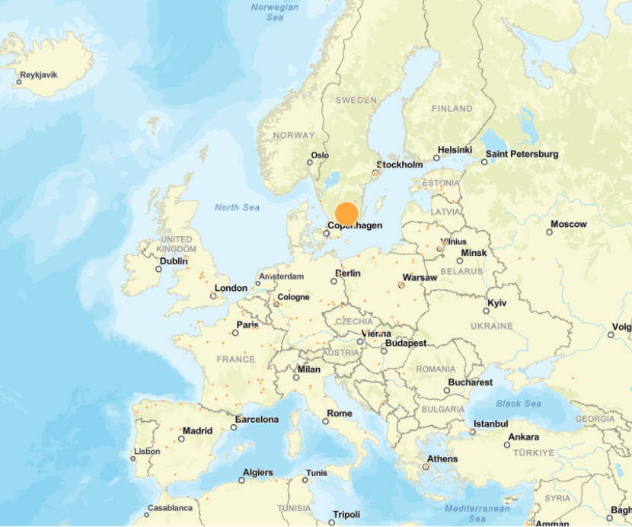
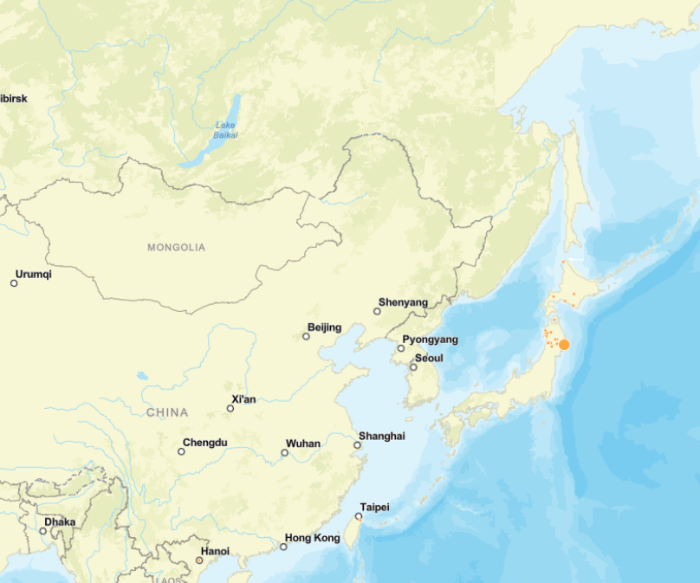
UFOs in Relation to Meteor locations

Slide 14
Positive Correlations
Only locations showing a positive correlation between meteor crashes and a high count of UFO sightings are below
- Topeka, Kansas
- Stockholm, Sweden
- Sendai, Japan

